Slide 1
FEDERAL REPUBLIC OF GERMANY
UNIVERSITY OF EUROPE FOR APPLIED SCIENCES
POTSDAM CAMPUS
Emotion detection from images Deep Learning model
Career: Software Engineering
Machine Learning
Semester: Summer
Sebastian Russo (Technical)
Javier Peres (Write-up)
Guillermo Trigo (Figures/Tables)
Potsdam, July, 2024

Slide 2
Sebastian Russo (Technical)
Javier Peres (Write-up)
Guillermo Trigo (Figures/Tables)

Slide 3
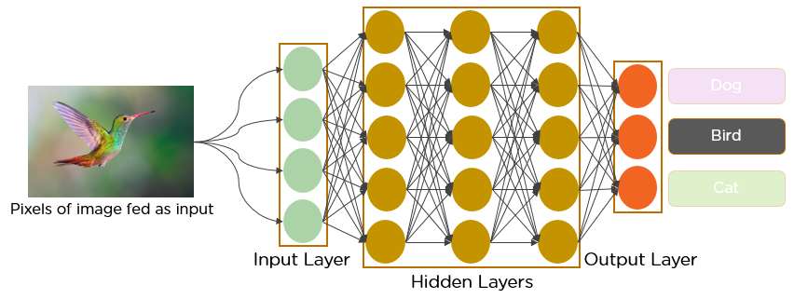
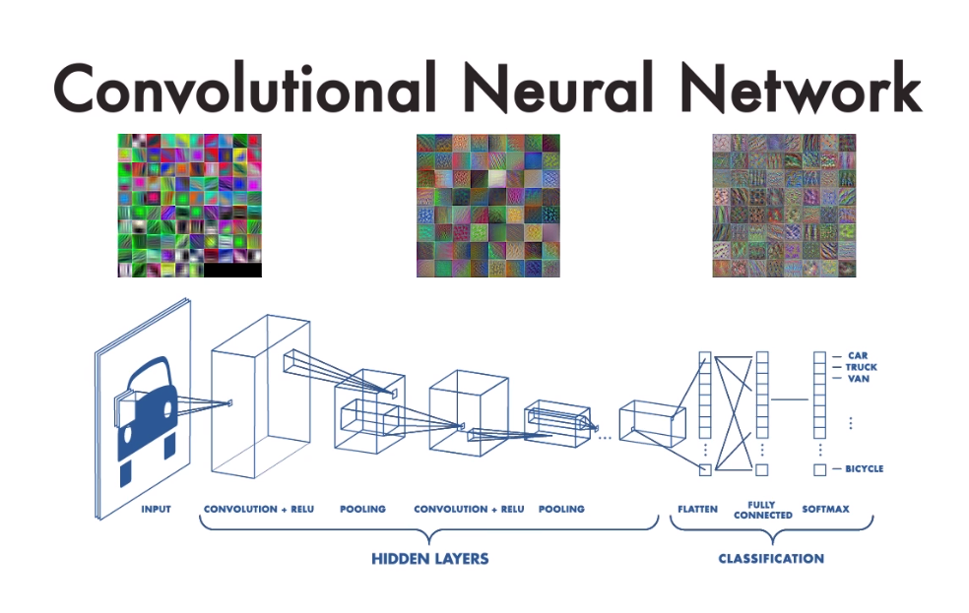
Deep learning model
"Emotion_Detection_from_images" is our code that attempts on identifying and classifying emotions by analyzing image files through the usage of a type of Deep Learning model known as Convolutional Neural Networks (CNNs), specifically DenseNet169
The code should be able to accept an image file (48x48 x 3RGB), recognize the emotion the person is expressing and return the corresponding label that mirrors that emotion

Slide 4
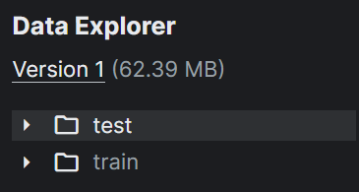
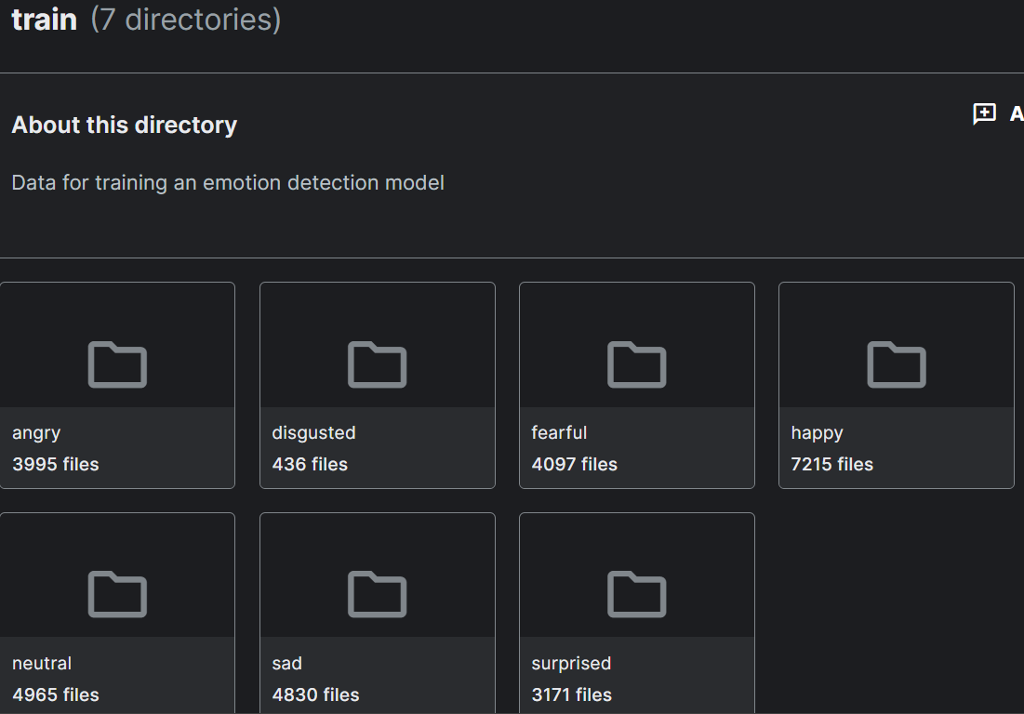
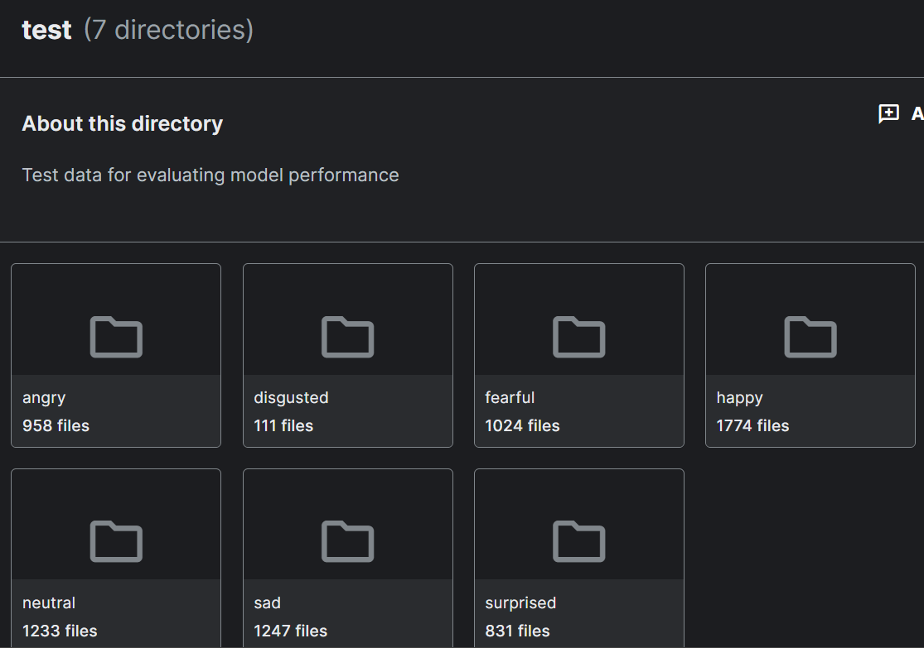
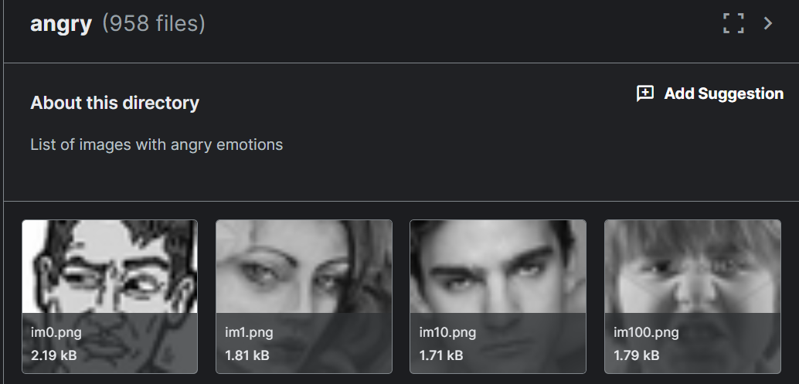
Dataset, Emotion Detection
The approved dataset was a 35,685 image files (.png) divided into 2 folders, train and test dataset downloaded from platform Kaggle.com
Each image is 48x48x3rgb pixel gray scale images of faces
Images should be categorized based on the 1 out of the 7 selected emotion shown in the facial expressions of the person in the image (happiness, neutral, sadness, anger, surprise, disgust, fear)

Slide 5
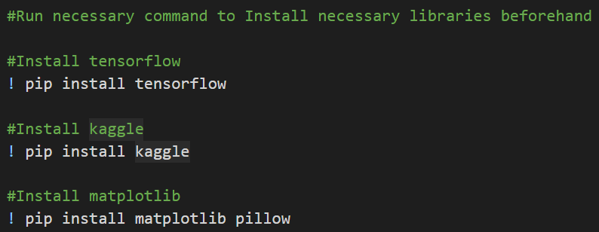

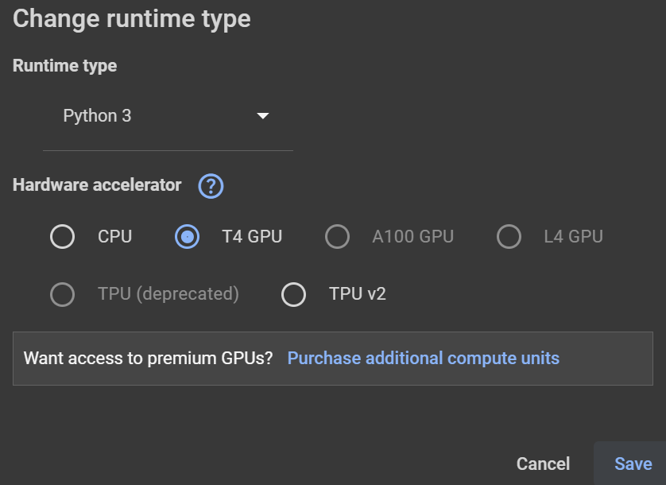
Prerequisites
Make sure runtime is computer’s GPU
Shell commands
Make sure Tensorflow is downloaded in your system (to implement the CNN)
Make sure Kaggle is downloaded in your system (to access and download dataset)
Make sure Matplotlib is downloaded in your system (for data visualization)
If not, it’s going to take forever

Slide 6
Deep learning model with Transfer Learning

Slide 7
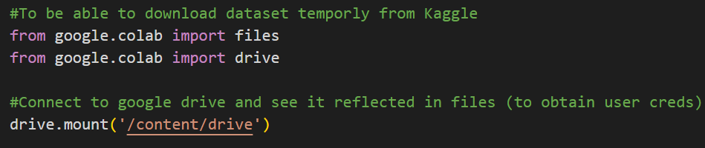
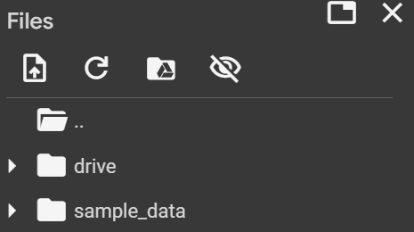
Dataset download pt.1
Kaggle.com allows its user to directly download datasets by providing a .json file with their username and an API key (its credentials)
Therefore, it was decided to upload said file to a private google drive to be accessed by the .ipynb code
Hence, it is necessary to use google colab libraries to import files and access google drive accounts to connect this file to the google drive and retrieve the necessary .json file to download the dataset

Slide 8
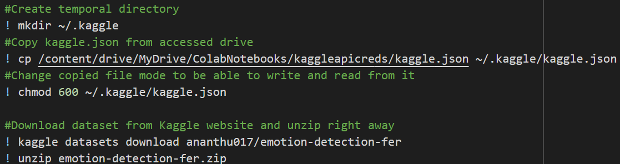
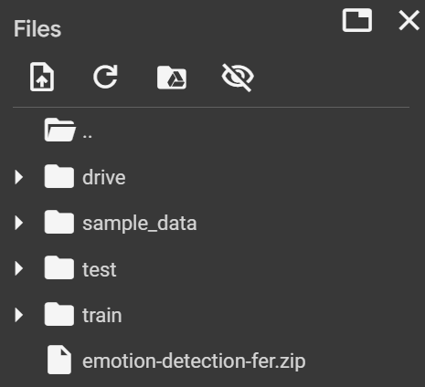
Dataset download pt.2
Shell commands
With access to the drive with the .json file, we create a temporal folder in which we will copy and paste the kaggle.json file (with its google drive file path) and change file mode so it can be read and be written on
Once with the necessary keys and credentials, we can use the command from Kaggle to download the dataset as a .zip file by providing userthatuploadedit/nameofthedataset
Lastly, since it is a .zip file, it must be unzipped to finally be ready to start

Slide 9
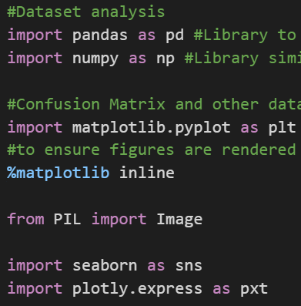
Import critical libraries pt.1
Pandas: For dataset manipulation and analysis
Numpy: For scientific computation in Python
Matplotlib.pyplot: To make this notebook work like MATLAB
%matplotlib inline: to ensure images are rendered within the notebook
PIL: For visualizing dataset images before Pre-processing
Seaborn: For data visualization enhancement like heatmaps
Potply.express: For high-level interface to create interactive and complex plots

Slide 10
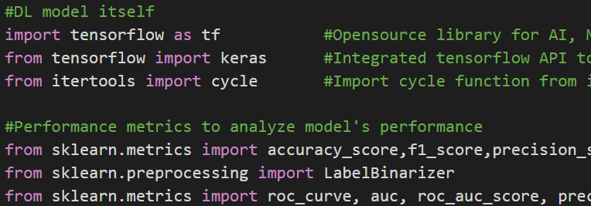
Import critical libraries pt.2
Tensorflow: It’s the opensource library for the deep learning model
Keras: To integrate the tensorflow API and implement high-level neural networks
Cycle: to make an iterator that repeats the elements in the given iterable indefinitely
Skelarn imports: In general, is to check the model's performance metrics and to preprocess the data

Slide 11
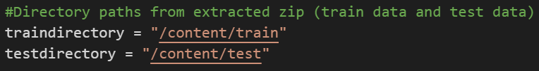
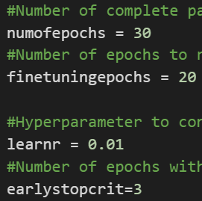
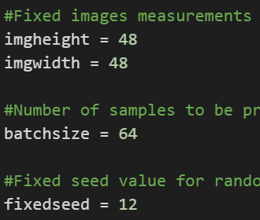
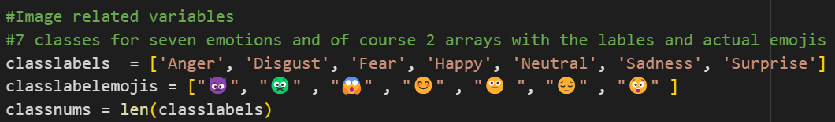
Hyperparameters and global variables
The general path to both test and train folders
# of full pass of the training dataset through the algo
To transfer learning from the parameters of a pre-trained model to new data
Learning rate (to reduce loss)
# of epochs with no improvement before forcing stop
Expected width and height of incoming image data points
Number of samples to be processed before model is updated
To ensure reproducibility in data generators
Classes

Slide 12
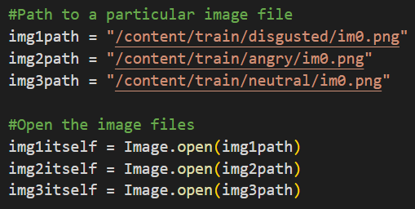
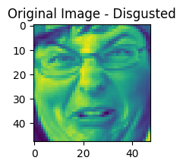
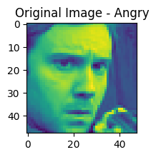
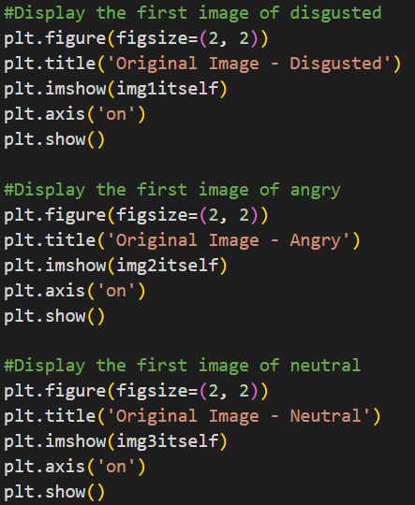
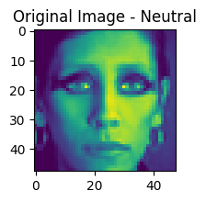
Data visualization (Before preprocess)
My face when bro says the most outlandish comment known to man

Slide 13
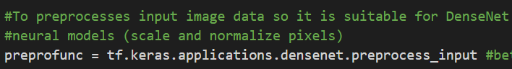
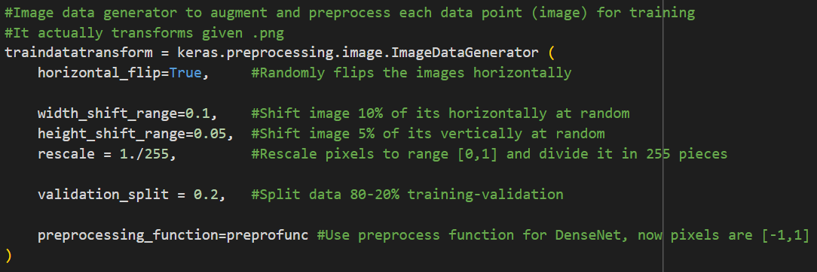
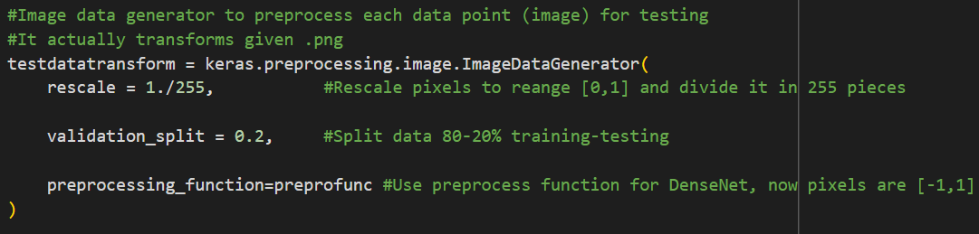
Data preprocessing pt.1

Slide 14
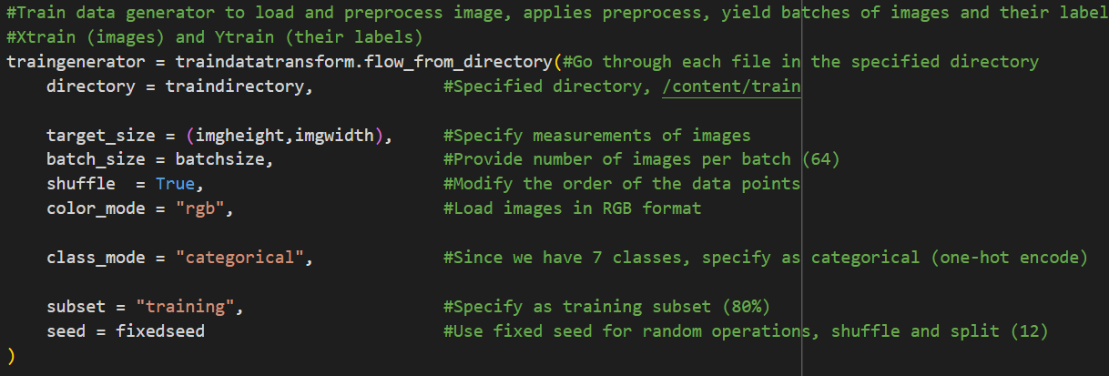
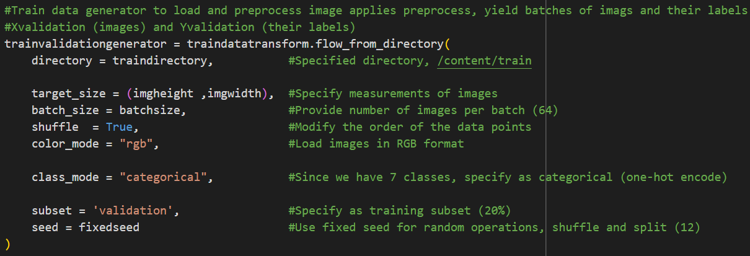
Data preprocessing pt.2

Slide 15
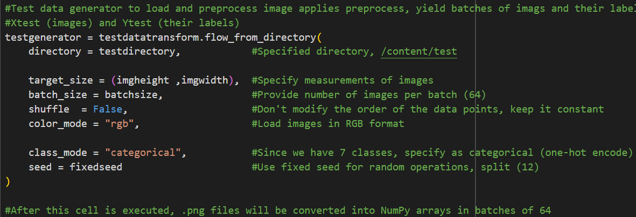
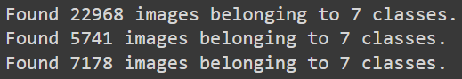
Data preprocessing pt.3

Slide 16
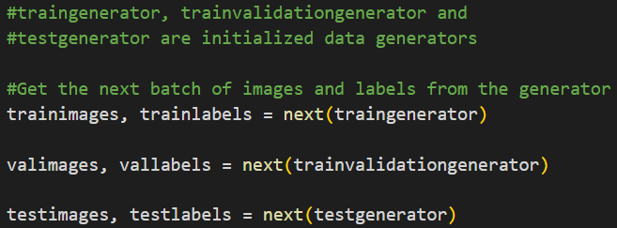
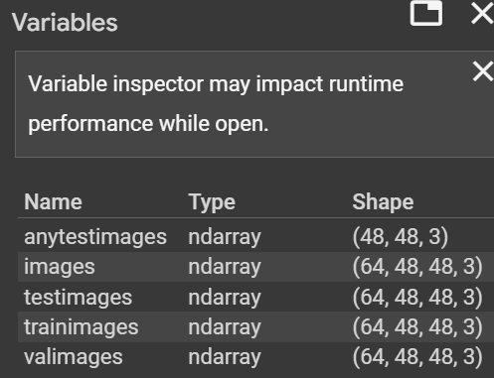
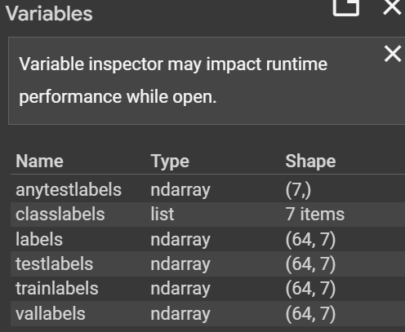
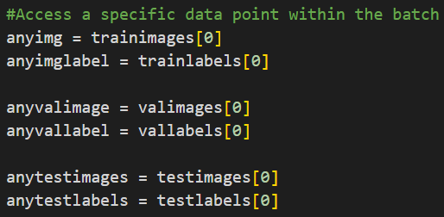
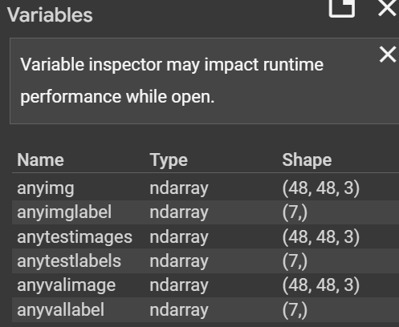
Visualize preprocessed data pt.1

Slide 17
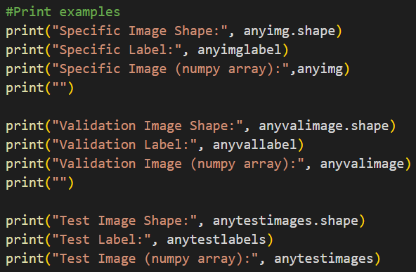
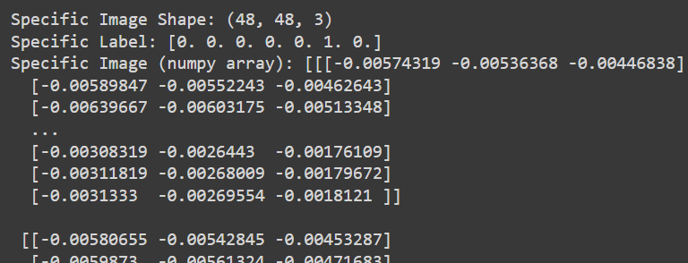
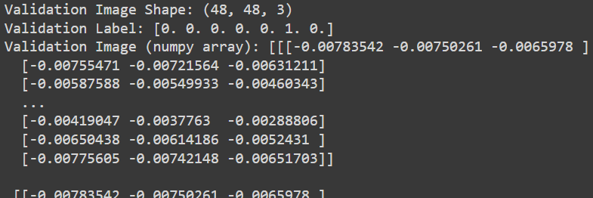
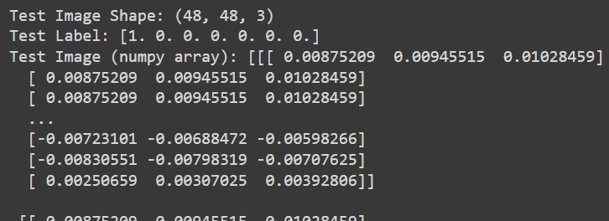
Visualize preprocessed data pt.2

Slide 18
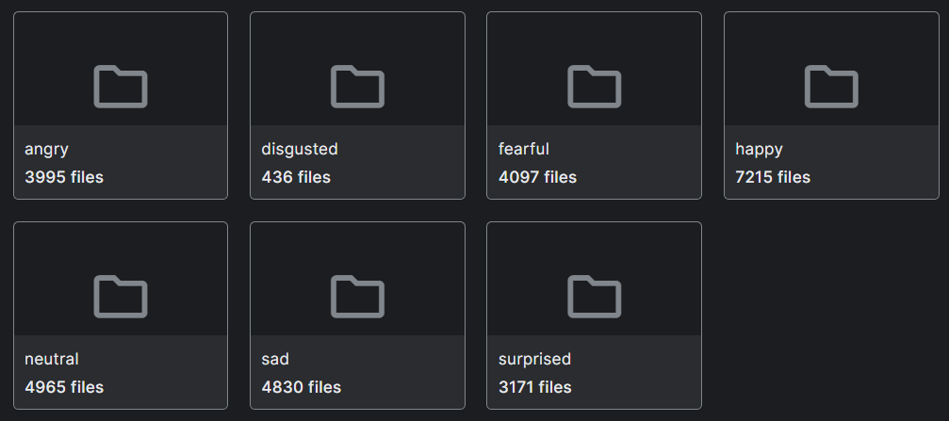
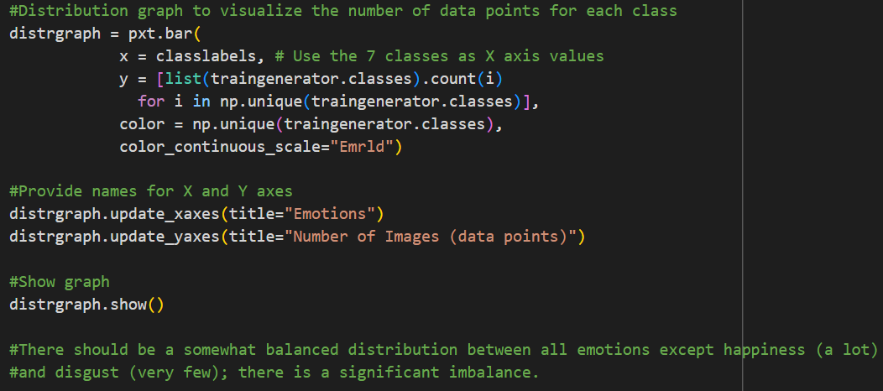
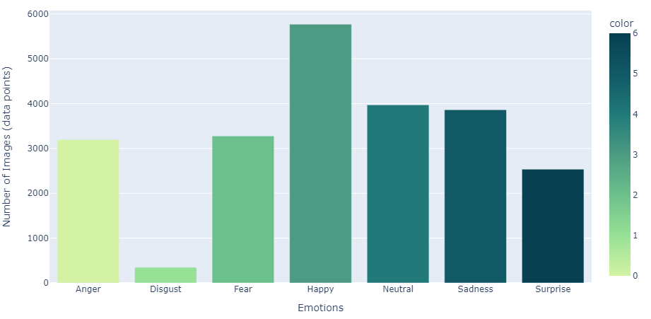
Analyze data distribution

Slide 19
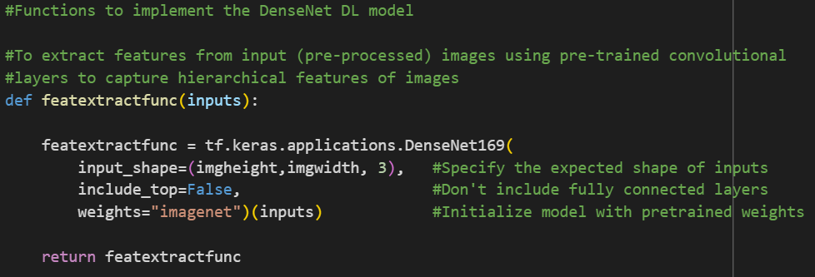
Functions to implement DenseNet model pt.1

Slide 20
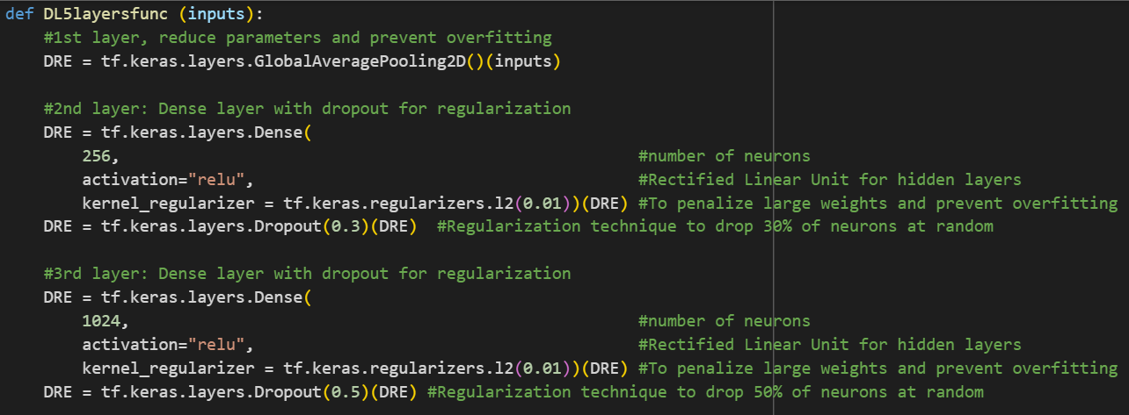
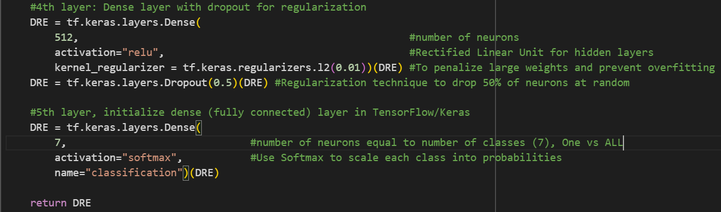
Functions to implement DenseNet model pt.2

Slide 21
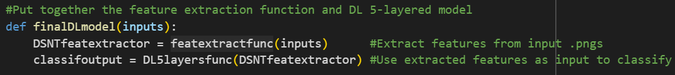
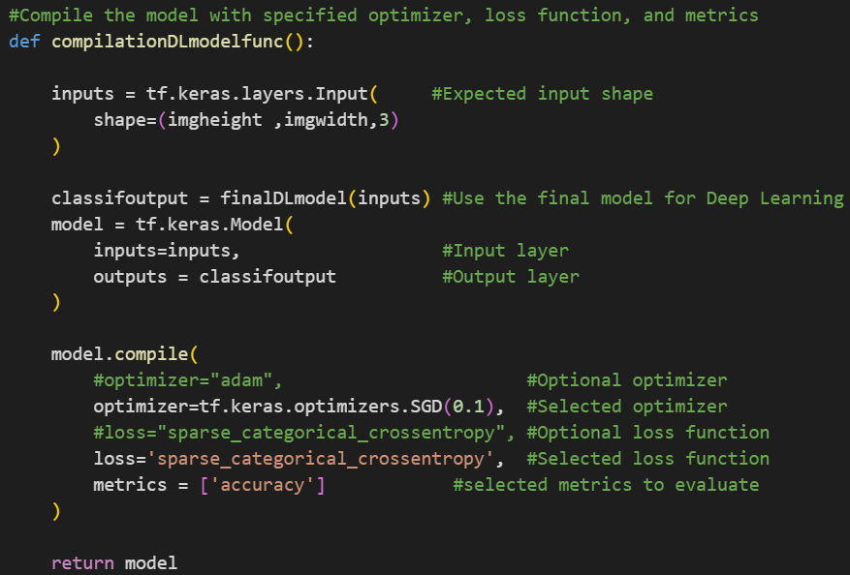
Functions to implement DenseNet model pt.3

Slide 22
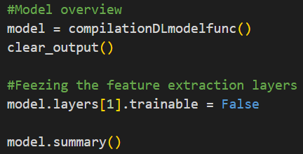
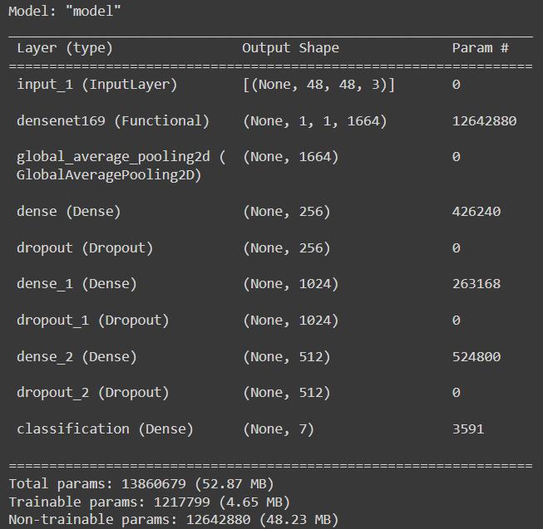
Overview the model you have created (a mess)

Slide 23
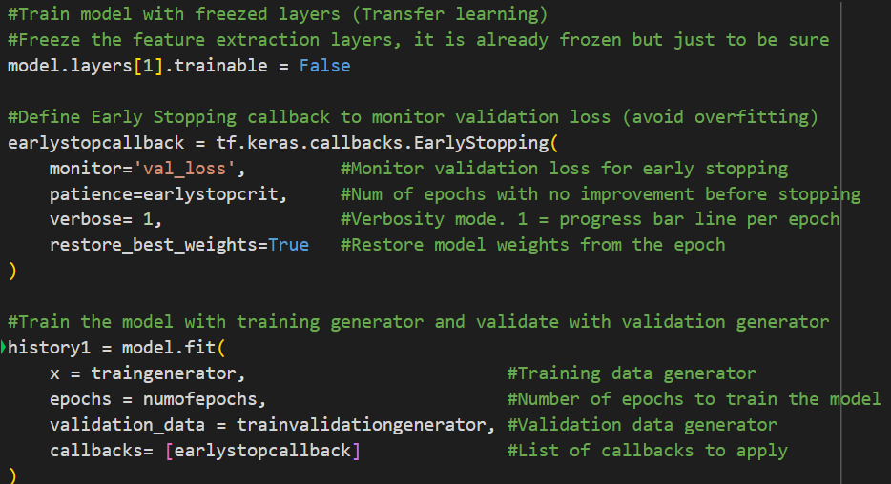



Model training, freezed layers pt.1
Iteration 1
CPU run
Whole run (only 6 epochs)
Iteration 2
CPU run
Setting the trainable attribute to false prevents weight from being updated and:
Leverage Pre-trained Knowledge: Freezing the CNN base (feature extractor), the feature extraction capabilities of the pre-trained model are enhanced (layers learned to detect edges, textures, shapes etc.)
Overfitting: Prevent layers from being updated during training to avoiding overfitting
Reduce Training Time: Train fewer layers means that the model trains faster with less resources.
Half of stated epochs done
Iteration 3
T4 GPU run
13 out of 30 epochs done

Slide 24



Model training, freezed layers pt.1
Iteration 4
T4 GPU run
10 out of 30 epochs done
Iteration 5
T4 GPU run
14 out of 30 epochs done
Iteration 6
CPU run
15 out of 30 epochs done

Slide 25





Model training, unfreezed layers (Fine-tuning) pt.1
Iteration 1
CPU run
Last 5 epochs
Iteration 2
CPU run
Setting the trainable attribute to true allows layers to be updated during training and:
Adapt to new Data: After initial training with frozen layers, model can be fine tuned to adapt better to specifics of a new dataset
Improve Performance: Allowing the pre-trained layers to learn and adjust to the new data, an even better performance is achieved
Last 5 epochs
Iteration 3
T4 GPU run
Last 5 epochs

Slide 26



Model training, unfreezed layers (Fine-tuning) pt.2
Iteration 4
T4 GPU run
Last 5 epochs
Iteration 5
T4 GPU run
Last 5 epochs
Iteration 6
CPU run
Last 5 epochs

Slide 27


Obtain history from freeze and unfreeze together

Slide 28




Accuracy vs number of Epochs pt.1
Iteration 1
CPU run
Iteration 3
T4 GPU run
Iteration 2
CPU run

Slide 29



Accuracy vs number of Epochs pt.2
Iteration 4
T4 GPU run
Iteration 5
T4 GPU run
Iteration 6
CPU run

Slide 30




Loss vs number of Epochs pt.1
Iteration 1
CPU run
Iteration 3
T4 GPU run
Iteration 2
CPU run

Slide 31



Loss vs number of Epochs pt.2
Iteration 4
T4 GPU run
Iteration 5
T4 GPU run
Iteration 6
CPU run

Slide 32

Evaluate model’s performance pt.1
Iteration 1
CPU run
Iteration 2
CPU run
Iteration 3
T4 GPU run

Slide 33
Evaluate model’s performance pt.2
Iteration 4
T4 GPU run
Iteration 5
T4 GPU run
Iteration 6
CPU run

Slide 34




Confusion matrix pt.1
Iteration 1
CPU run
Iteration 2
CPU run
Iteration 3
T4 GPU run
Iteration 4
T4 GPU run

Slide 35


Confusion matrix pt.2
Iteration 5
T4 GPU run
Iteration 6
CPU run

Slide 36






ROC: Receiver operating characteristic
Iteration 1
CPU run
Iteration 2
CPU run
Iteration 3
T4 GPU run
Iteration 4
T4 GPU run
Iteration 5
T4 GPU run
Iteration 6
CPU run

Slide 37






Precision-Recall curve
Iteration 1
CPU run
Iteration 2
CPU run
Iteration 3
T4 GPU run
Iteration 4
T4 GPU run
Iteration 5
T4 GPU run
Iteration 6
CPU run

Slide 38






Classification report
Iteration 1
CPU run
Iteration 3
Iteration 5
T4 GPU run
T4 GPU run
Iteration 2
CPU run
Iteration 4
T4 GPU run
Iteration 6
CPU run

Slide 39

Save trained model back in google drive
We ended up using the 2nd Iteration model

Slide 40
Deep learning model without Transfer Learning

Slide 41
Similarities and Differences
“The 2 codes are almost the same, with the big difference that in this case we won’t use Transfer learning, therefore, the following Python Cell will be deleted and the model will be trained/adapted only with Unfreezed layers, therefore we will see how this affect the performance, in the following slides we will see other major changes in comparison to the previous model

Slide 42

Hyperparameters and global variables changes
Same
Only number of epochs and the learning rate set to 0.01
Same
Same

Slide 43


Overview the model you have created (changes)

Slide 44




Model training (straight unfreezed layers) pt.1
Iteration 1
CPU run
Last 5 epochs
Iteration 2
CPU run
Setting the trainable from the get-go attribute to true allows layers to be updated during training and:
Adapt to new Data: After initial training with frozen layers, model can be fine tuned to adapt better to specifics of a new dataset
Improve Performance: Allowing the pre-trained layers to learn and adjust to the new data, an even better performance
Last 5 epochs
Iteration 3
T4 GPU run
Last 5 epochs

Slide 45



Model training (straight unfreezed layers) pt.2
Iteration 4
T4 GPU run
Last 5 epochs
Iteration 5
T4 GPU run
Last 5 epochs
Iteration 6
CPU run
Last 5 epochs

Slide 46


Obtain history from the only compilation

Slide 47



Accuracy vs number of Epochs pt.1
Iteration 1
CPU run
Iteration 3
T4 GPU run
Iteration 2
CPU run

Slide 48



Accuracy vs number of Epochs pt.2
Iteration 4
T4 GPU run
Iteration 5
T4 GPU run
Iteration 6
CPU run

Slide 49



Loss vs number of Epochs pt.1
Iteration 1
CPU run
Iteration 3
T4 GPU run
Iteration 2
CPU run

Slide 50



Loss vs number of Epochs pt.2
Iteration 4
T4 GPU run
Iteration 5
T4 GPU run
Iteration 6
CPU run

Slide 51
Evaluate model’s performance pt.1
Iteration 1
CPU run
Iteration 2
CPU run
Iteration 3
T4 GPU run

Slide 52
Evaluate model’s performance pt.2
Iteration 4
T4 GPU run
Iteration 5
T4 GPU run
Iteration 6
CPU run

Slide 53




Confusion matrix pt.1
Iteration 1
CPU run
Iteration 2
CPU run
Iteration 3
T4 GPU run
Iteration 4
T4 GPU run

Slide 54


Confusion matrix pt.2
Iteration 5
T4 GPU run
Iteration 6
CPU run

Slide 55





ROC: Receiver operating characteristic
Iteration 1
CPU run
Iteration 2
CPU run
Iteration 3
T4 GPU run
Iteration 4
T4 GPU run
Iteration 5
T4 GPU run
Iteration 6
CPU run

Slide 56





Precision-Recall curve
Iteration 1
CPU run
Iteration 2
CPU run
Iteration 3
T4 GPU run
Iteration 4
T4 GPU run
Iteration 5
T4 GPU run
Iteration 6
CPU run

Slide 57






Classification report
Iteration 1
CPU run
Iteration 3
Iteration 5
T4 GPU run
T4 GPU run
Iteration 2
CPU run
Iteration 4
T4 GPU run
Iteration 6
CPU run

Slide 58

Save trained model back in google drive
We ended up using the 6th Iteration model, also, it is saved in a different folder in Google drive

Slide 59
UI (User Interface)

Slide 60

Prerequisites
This file was built in a local python environment for ease of access to device’s hardware

Slide 61

Import critical libraries
tensorflow: opensource library for the deep learning model
image: image processing and manipulation
numpy: For scientific computation in Python
cv2: To perform operations on images and videos

Slide 62


Hyperparameters and global variables
Expected width and height of incoming image data points
Classes
Load both DL models for the user to choose one or another

Slide 63


Functions for image preprocessing and prediction
This function takes the input image and preprocess it to the expected and suitable input for the DL model to make a prediction
This function makes a prediction by taking the selected model and preprocessed image

Slide 64

CV2 initialization
Use OpenCV (cv2) to capture video from the device’s webcam, detect faces in real-time using a pre-trained Haar Cascade classifier and then save the video with overlaid face detection rectangles

Slide 65

UI visualization pt.1
Makes the user choose between the 2 available trained DL models, then based on their input and assigns the selected model to a variable named “selected_model”.

Slide 66



UI visualization pt.2
This part implements the real-time face detection and emotion recognition system using OpenCV for webcam access and image capture while also utilizing the selected model for real time classification.
It also preprocesses each frame of the video, hence the infinite while loop
To release resources and close the window with video capture and display

Slide 67
THANKS FOR YOUR ATTETION

